Slide 1

BAN 612: Data Collection
Soon Chye Lim

Slide 2
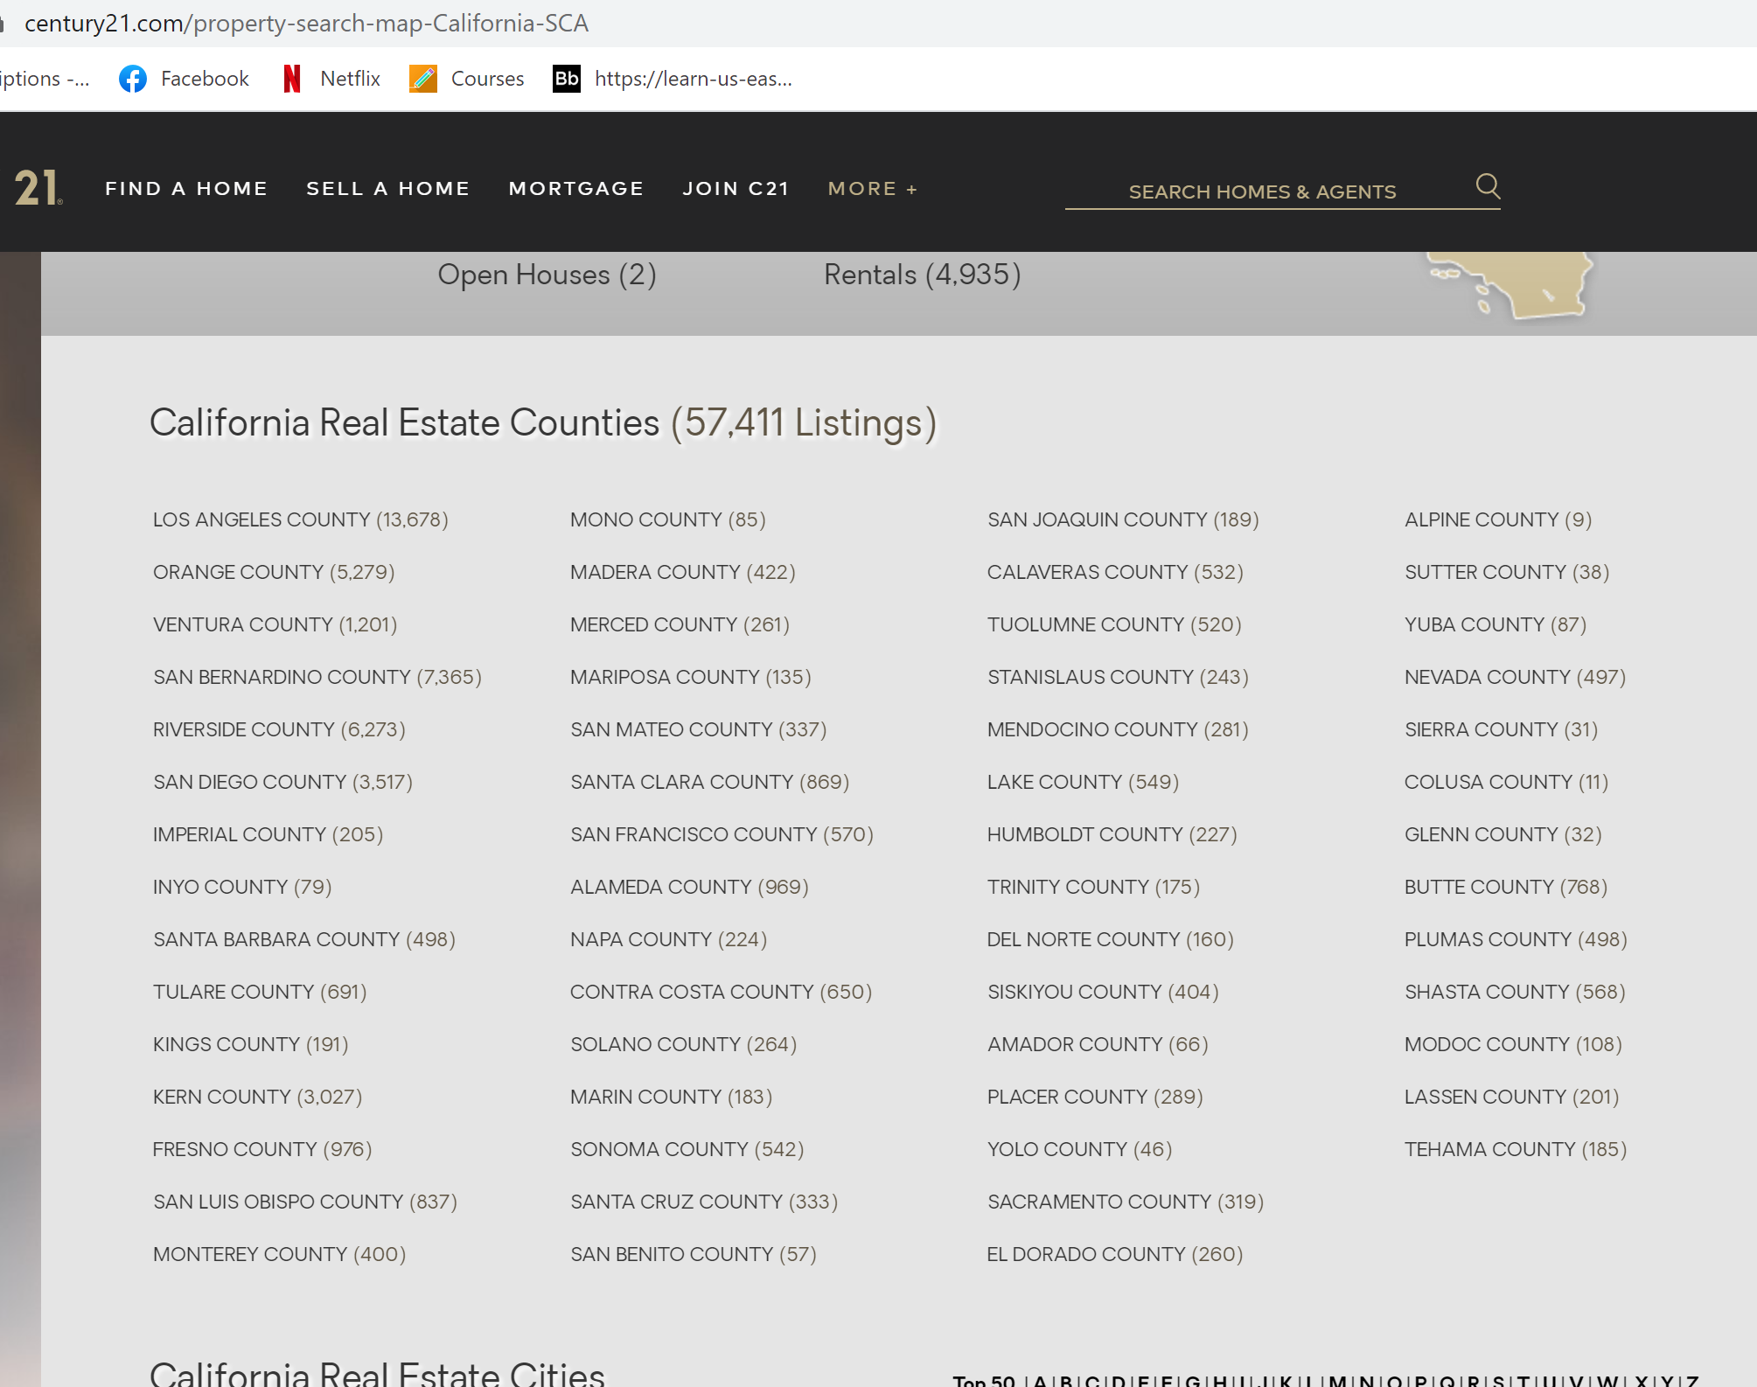
Roadmap to collect the data:
I googled and found out there are 9 counties in the bay area.
Using this list, I scraped the data from each of the 9 counties on this link.
I scraped with the following attributes:
Property address
City
Zip code
Agent
For sale or not
Price
Number of bedrooms
Number of bathrooms
Size of the property in sq ft
County

Slide 3
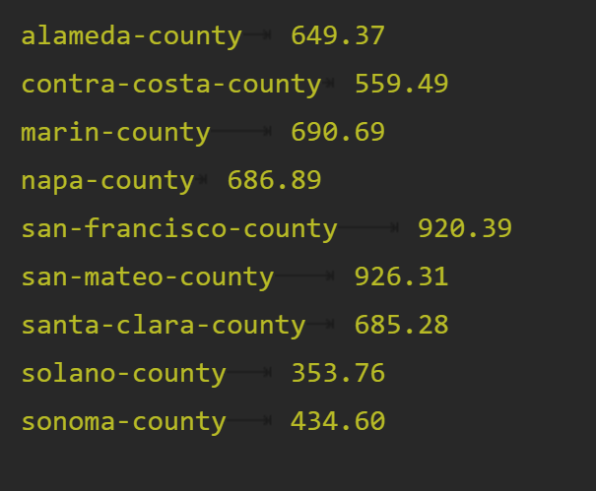
Roadmap to Data Cleaning – Part 1:
1. I filled all null values of Agent to None.
2. I filled all null values of Half Baths to 0.
3. There were so many missing sq ft, so I calculated the PSF (price per square foot) as a guide to calculate the missing sq ft. PSF is calculated by taking the average value of Price/Sq Ft grouped by each county.
As you can see the picture from the right, these are the average PSF for each county. To estimate the missing sq ft for each individual property, I used the formula below: Sq Ft = Housing Price / PSF

Slide 4
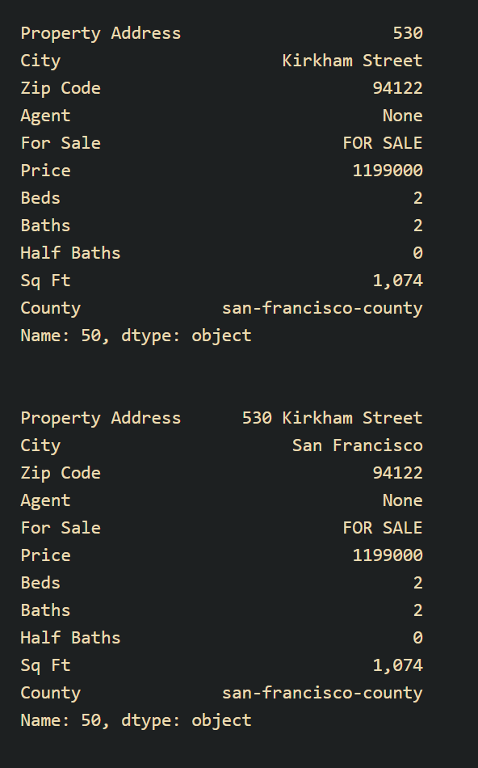
Roadmap to Data Cleaning – Part 1:
4. I removed all null values of the data that did not have numbers of bedroom and bathroom.
5. Looking at every row individually, I noticed row 43 was inconsistent. I replaced the value with the appropriate values as shown in the picture to the right.
6. Finally, I remove duplicates in the data frame.

Slide 5
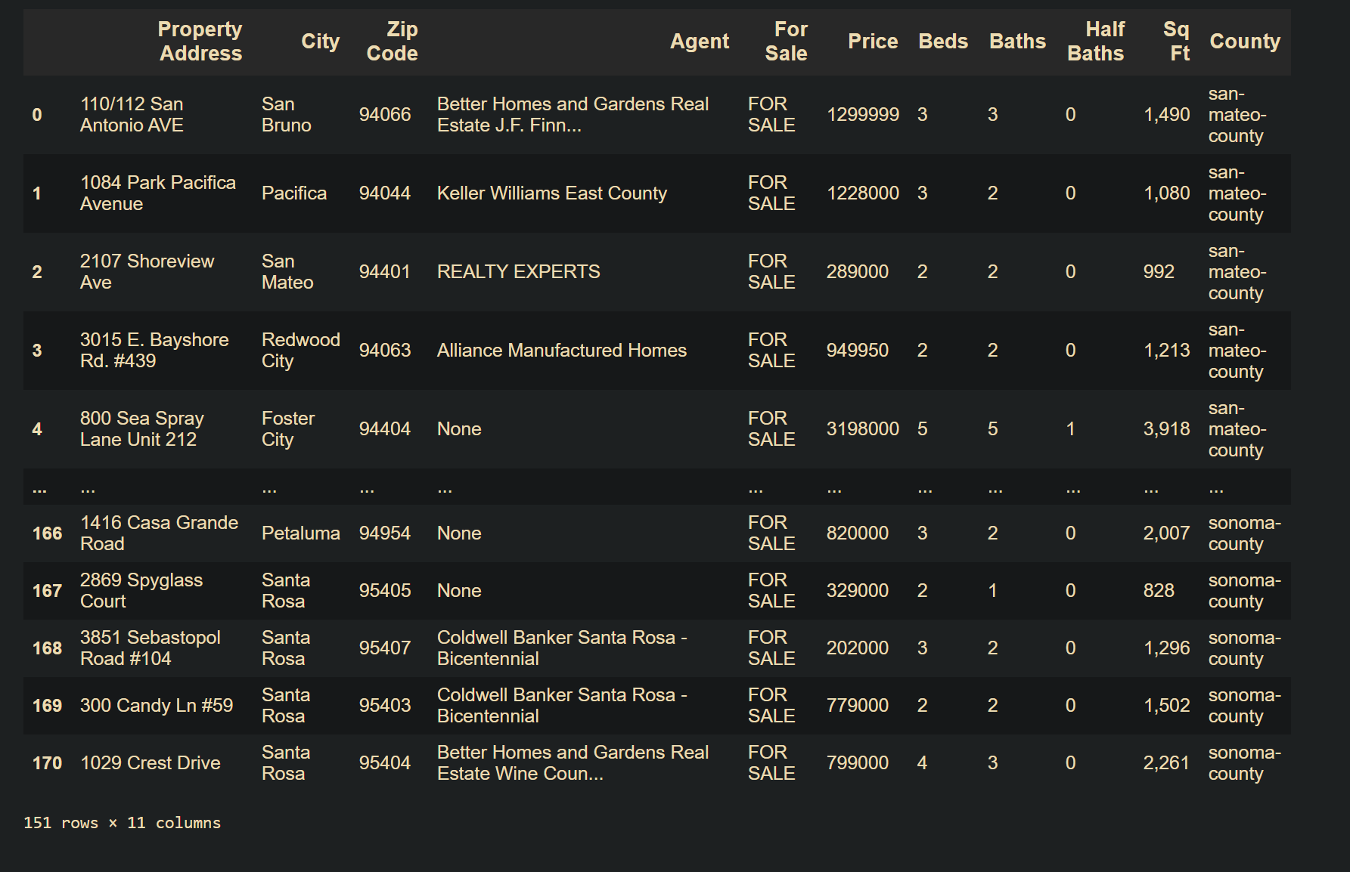
Result:

